Slide 1

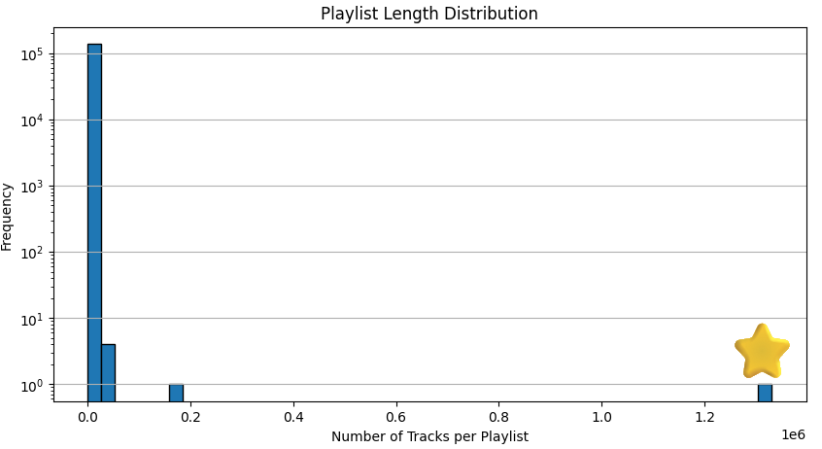


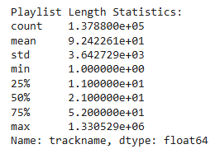

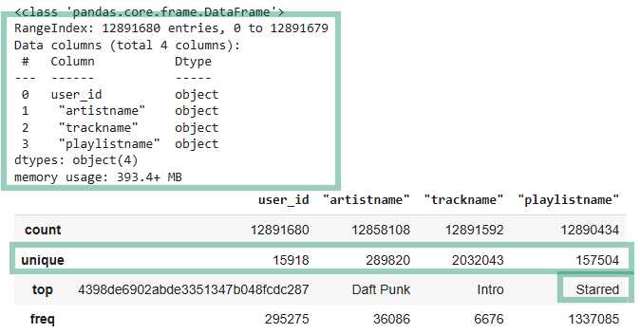

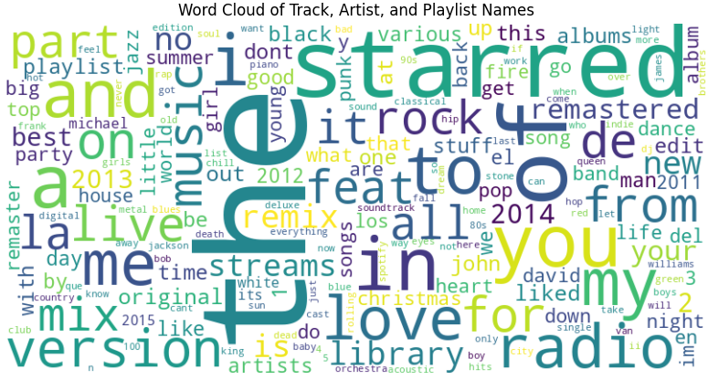
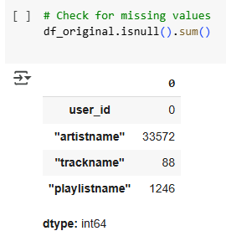
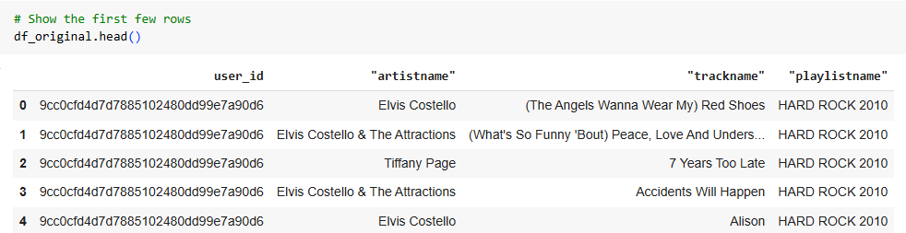

Playlist Recommender System
Business question ? "How can we develop a system to recommend personalized playlists to users, leveraging playlist data alone to identify contextual relationships between songs and generate relevant suggestions for a given input song?“
Link to GitHub Repo.
Data Set from Kaggle: Spotify-playlists
RAW DATA
Created by: Manor Shpritz & Ortal Lasry & Or Cohen Raviv.
[Final Project @ – Practical Data Science course 2024-2025]
** Spotify logo and data are copyrighted by Spotify and used for educational purposes only.

Slide 2

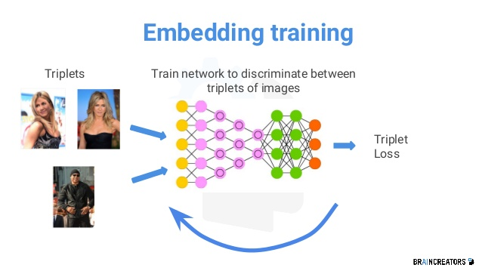
Song Recommendation Model Using a Siamese Network
Siamese Network
Pairwise Similarity: Can analyze songs pairs
Flexibility: Learns embeddings that adapt to new playlists.
Sparse Data Efficiency: Manages implicit song relationships in large, sparse datasets.
Loss Function - Triplet Loss: Ensures songs in the same playlist are closer in the embedding space than those that are unrelated.
Triplet Structure:
Anchor Song A song from the playlist.
Positive Song Another song from the same playlist.
Negative Song A song not in the playlist.
Triplet Generation Process:
Balanced Sampling of Easy Negatives and Hard Negatives:
Diversity Logic to ensure wide coverage of songs.
Validation
Probability Calculation:
cosine similarity between embeddings
Ranking Metrics:
Precision@K
Recall@K
Mean Average Precision (MAP)

Slide 3
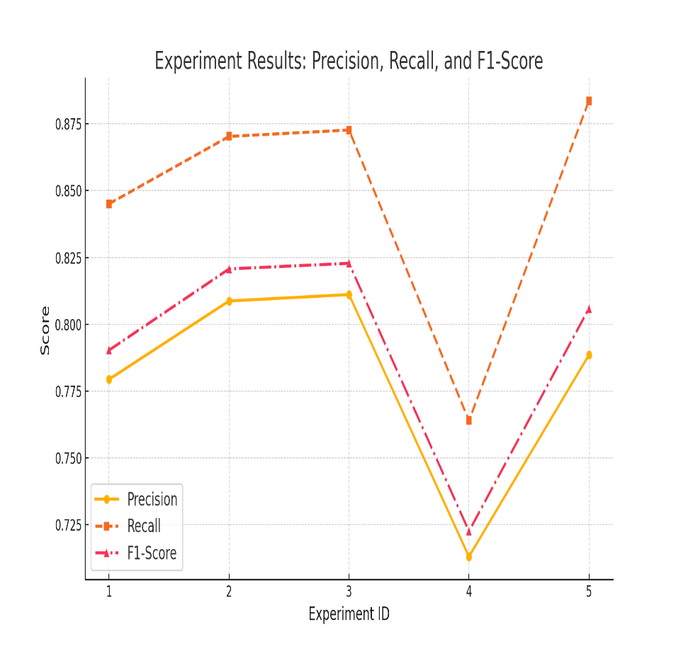
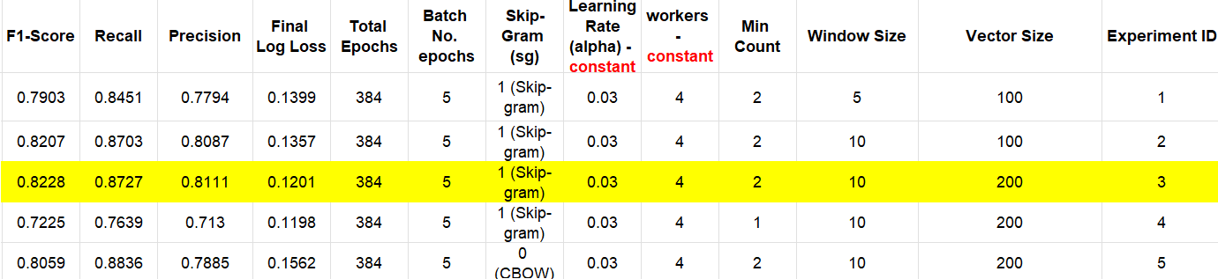
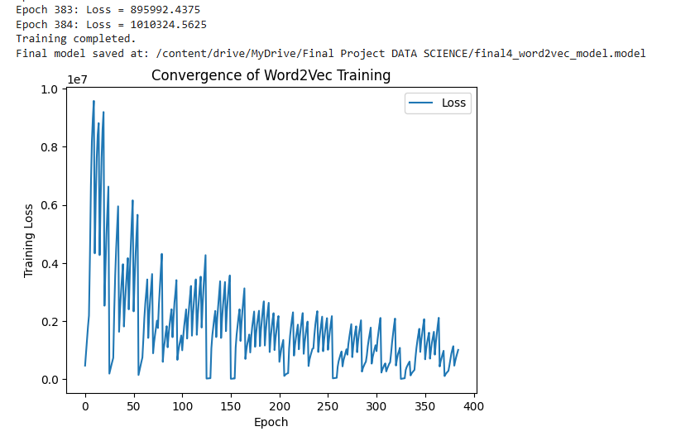
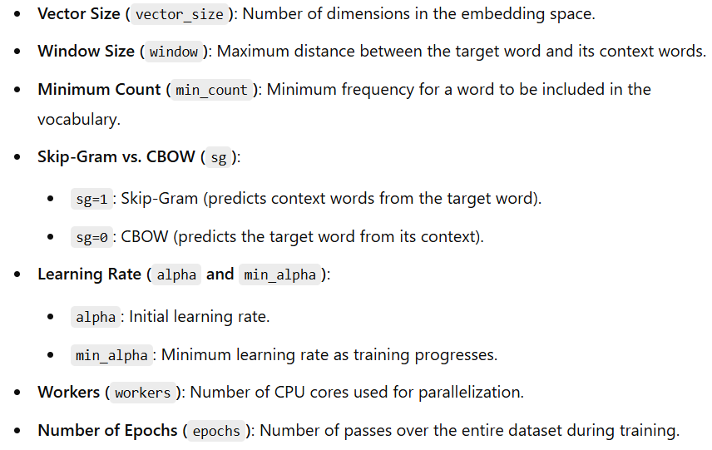
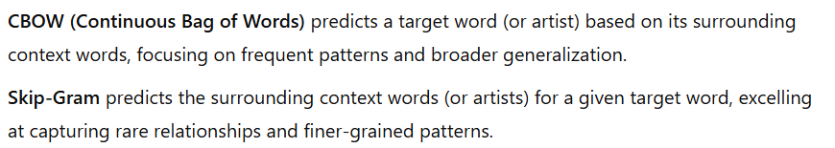
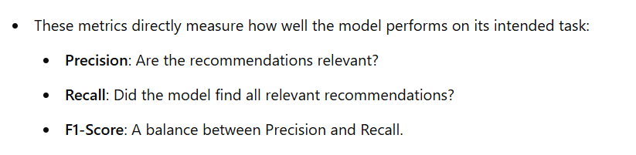

Word2Vec Recommender System
*Artist-based word2vec model recommender*
Best model chosen is 3 based on best F1 score

Slide 4
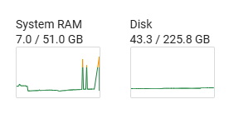

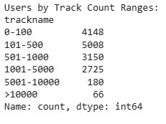
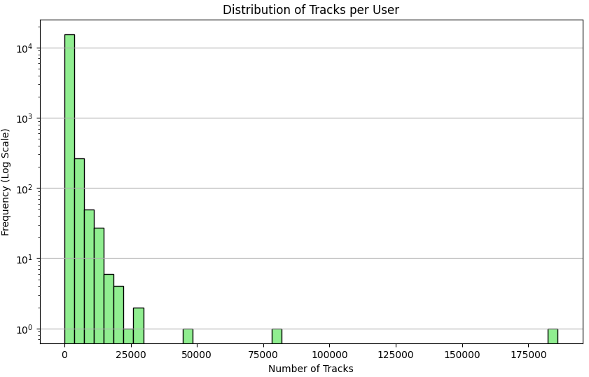

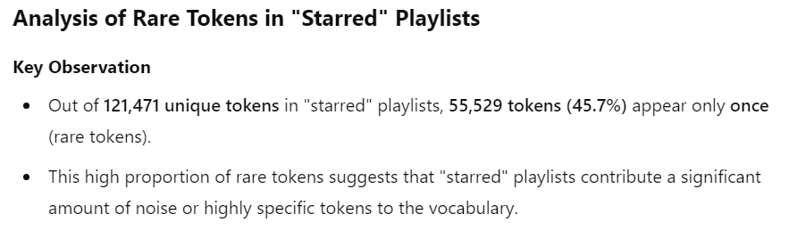
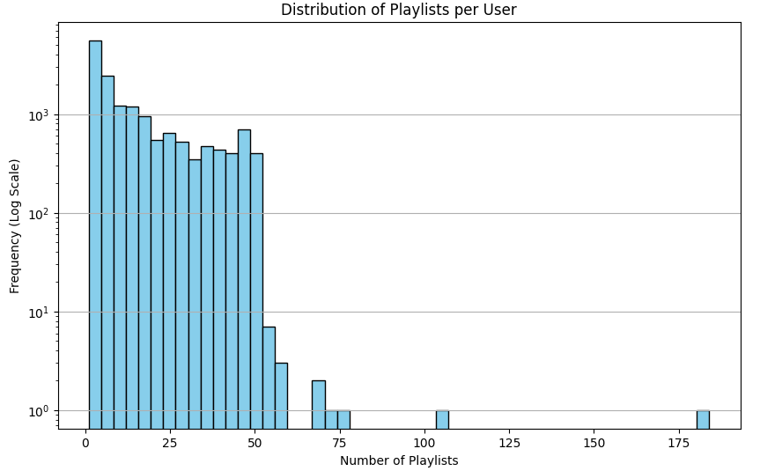


Key Intakes
Triplet Loss Model | Word2Vec | Aspect
Siamese Network with Triplet Loss | Skip-gram embedding model | Model & Training
Learn context-aware song embeddings | Embed songs to capture relationships | Goal
Triplets: Anchor, Positive, Negative songs | artist names as tokens | Input Data
Triplet Loss (minimizing anchor-positive distance vs. anchor-negative) | Skip-gram | Best Training Method
Song embeddings optimized for playlist context | Song embeddings in a vector space | Output
Precision@K, Recall@K, MAP | F1-Score, Precision@K, Recall@K | Evaluation Metrics
Model ??? with MAP of ???% | Model 3 (F1: 82.3%) | Best Performance
Computationally expensive, sensitive to sampling | Easy to implement, good for large datasets | Strengths
Computationally expensive, sensitive to sampling | Struggles with playlist-specific context | Weaknesses
Context-aware playlist creation | General song recommendations | Use Case Fit
GPU | CPU | computational requirements
Challenges (Bias & Outliers) :
Balance
Key improvements : To be continued…

